Slide 1
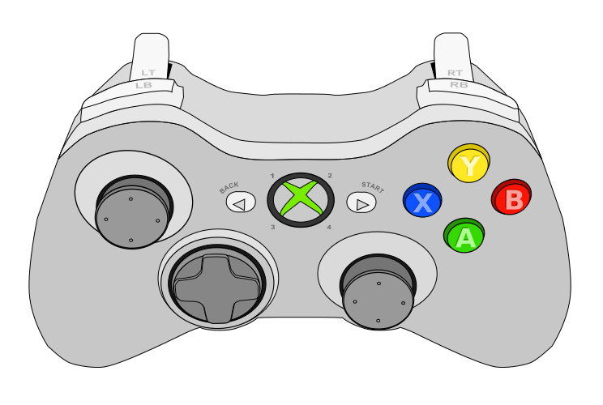
Algae INTAKE Ground
Coral INTAKE
Algae INTAKE Lollipop
STOP All Motors
Home Sequence
L4 Sequence
While Held With Driver
CLIMBER MANUAL
While Held, Up/Down
L3 Sequence
While Held With Driver
L2 Sequence
While Held With Driver
Processor PREP
Net PREP
Algae INTAKE
Reef Upper SEQUENCE
While Held With Driver
Algae INTAKE
Reef Lower SEQUENCE
While Held With Driver
Elevator MANUAL
While Held, Up/Down
L1 Sequence
While Held With Driver

Slide 2
DRIVE JOYSTICK
Turn JOYSTICK
Drive to Barge To Score Algae
While Held, Move Side-To-Side to Strafe Along Barge
Release/Score Algae
Release/Score Coral
Drive to Reef and Score Coral
Drive to Reef and INTAKE ALGAE
While Held with Co-Driver, Move Side-To-Side to Jog Between Reef Branches

Slide 3

No climber
Reef
Elevator
Hopper
L4
Fwd
L3
Rev
Reef
Wrist
Coral
Reset Pose
L2
Fwd
L1
Rev
Release
Calibrate
Algae
Cor
Elv
In
Alg
Wri
Out

Slide 4
With climber
Reef
Wrist
Hopper
Climber Cal
L4
Fwd
L3
Rev
Reef
Calibrate
Coral
Reset Pose
L2
Elv
Fwd
L1
Wri
Rev
Climber
Climber
Algae
Lift
NTRL
In
Prep
STRT
Out

Slide 5
Match Timer
10-Second Countdown
Disabled
Animated
Automated Drive/Score Complete
Automated Drive/Score
In Progress
Algae Mode
Flashing While Intaking
Coral Mode
Flashing While Intaking

